Slide 1
SINGLY LINKED LIST

Slide 2

INTRODUCTION
A singly linked list is the simplest type of linked list in which every node contains some data and a pointer to the next node of the same data type.
The node contains a pointer to the next node, we mean that the node stores the address of the next node in sequence.
A singly linked list allows traversal of data only in one way.
Figure shows a singly linked list.

Slide 3

Traversing a Linked List
Traversing a linked list means accessing the nodes of the list in order to perform some processing on them.
Remember a linked list always contains a pointer variable START which stores the address of the first node of the list.
End of the list is marked by storing NULL or –1 in the NEXT field of the last node.
For traversing the linked list, we also make use of another pointer variable PTR which points to the node that is currently being accessed.
The algorithm to traverse a linked list is shown in Fig.
In this algorithm, we first initialize PTR with the address of START.
So now, PTR points to the first node of the linked list.
Then in Step 2, a while loop is executed which is repeated till PTR processes the last node, that is until it encounters NULL.
In Step 3, we apply the process (e.g., print) to the current node, that is, the node pointed by PTR.
In Step 4, we move to the next node by making the PTR variable point to the node whose address is stored in the NEXT field.

Slide 4
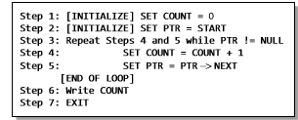
Traversing a Linked List
Let us now write an algorithm to count the number of nodes in a linked list.
To do this, we will traverse each and every node of the list and while traversing every individual node, we will increment the counter by 1.
Once we reach NULL, that is, when all the nodes of the linked list have been traversed, the final value of the counter will be displayed.
Figure shows the algorithm to print the number of nodes in a linked list.

Slide 5
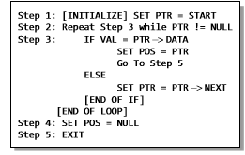
Searching for a value in a Linked List
Searching a linked list means to find a particular element in the linked list.
A linked list consists of nodes which are divided into two parts, the information part and the next part.
So searching means finding whether a given value is present in the information part of the node or not.
If it is present, the algorithm returns the address of the node that contains the value.
Figure shows the algorithm to search a linked list.
In Step 1, we initialize the pointer variable PTR with START that contains the address of the first node.
In Step 2, a while loop is executed which will compare every node’s DATA with VAL for which the search is being made.
If the search is successful, that is, VAL has been found, then the address of that node is stored in POS and the control jumps to the last statement of the algorithm.
However, if the search is unsuccessful, POS is set to NULL which indicates that VAL is not present in the linked list.

Slide 6
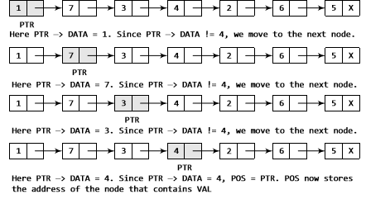
Searching for a value in a Linked List
Consider the linked list shown in Fig.
If we have VAL = 4, then the flow of the algorithm can be explained as shown in the figure.

Slide 7
Inserting a new node in a Linked List
In this section, we will see how a new node is added into an already existing linked list.
We will take four cases and then see how insertion is done in each case.
Case 1: The new node is inserted at the beginning.
Case 2: The new node is inserted at the end.
Case 3: The new node is inserted after a given node.
Case 4: The new node is inserted before a given node.
Before we describe the algorithms to perform insertions in all these four cases, let us first discuss an important term called OVERFLOW.
Overflow is a condition that occurs when AVAIL = NULL or no free memory cell is present in the system.
When this condition occurs, the program must give an appropriate message.

Slide 8
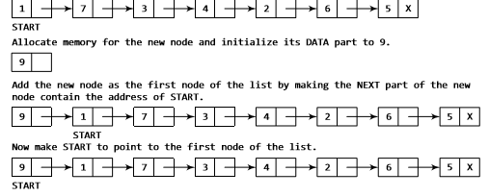
Inserting a Node at the Beginning of a Linked List
Consider the linked list shown in Fig.
Suppose we want to add a new node with data 9 and add it as the first node of the list.
Then the following changes will be done in the linked list.

Slide 9
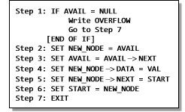
Inserting a Node at the Beginning of a Linked List
Figure shows the algorithm to insert a new node at the beginning of a linked list.
In Step 1, we first check whether memory is available for the new node.
If the free memory has exhausted, then an OVERFLOW message is printed.
Otherwise, if a free memory cell is available, then we allocate space for the new node.
Set its DATA part with the given VAL and the NEXT part is initialized with the address of the first node of the list, which is stored in START.
Now, since the new node is added as the first node of the list, it will now be known as the START node, that is, the START pointer variable will now hold the address of the NEW_NODE.
Note the following two steps:
Step 2: SET NEW_NODE = AVAIL
Step 3: SET AVAIL = AVAIL -> NEXT
These steps allocate memory for the new node.
In C, there are functions like malloc(), alloc, and calloc() which automatically do the memory allocation on behalf of the user.

Slide 10
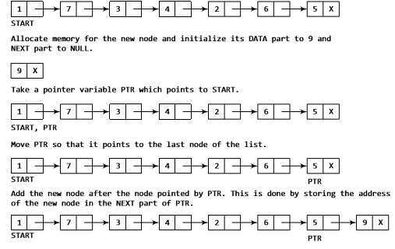
Inserting a Node at the End of a Linked List
Consider the linked list shown in Fig.
Suppose we want to add a new node with data 9 as the last node of the list.
Then the following changes will be done in the linked list.
Figure shows the algorithm to insert a new node at the end of a linked list.
In Step 6, we take a pointer variable PTR and initialize it with START.
That is, PTR now points to the first node of the linked list.
In the while loop, we traverse through the linked list to reach the last node.
Once we reach the last node, in Step 9, we change the NEXT pointer of the last node to store the address of the new node.
Remember that the NEXT field of the new node contains NULL, which signifies the end of the linked list.

Slide 11
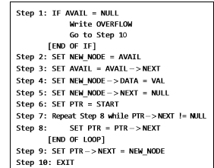

Slide 12
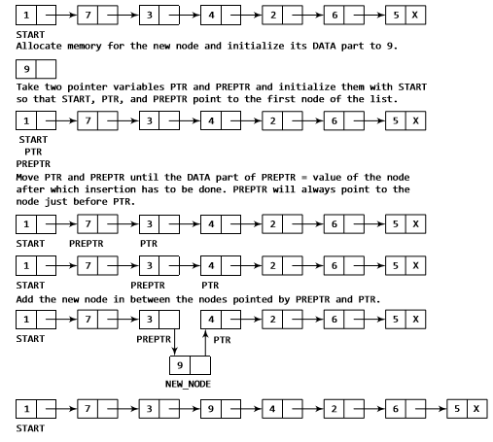
Inserting a Node After a Given Node in a Linked List

Slide 13
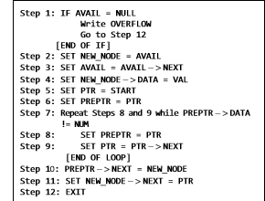
Inserting a Node After a Given Node in a Linked List
Consider the linked list shown in Fig.
Suppose we want to add a new node with value 9 after the node containing data 3.
Before discussing the changes that will be done in the linked list, let us first look at the algorithm shown in Fig.
In Step 5, we take a pointer variable PTR and initialize it with START.
That is, PTR now points to the first node of the linked list.
Then we take another pointer variable PREPTR which will be used to store the address of the node preceding PTR.
Initially, PREPTR is initialized to PTR.
So now, PTR, PREPTR, and START are all pointing to the first node of the linked list.
In the while loop, we traverse through the linked list to reach the node that has its value equal to NUM.
We need to reach this node because the new node will be inserted after this node.
Once we reach this node, in Steps 10 and 11, we change the NEXT pointers in such a way that new node is inserted after the desired node.

Slide 14
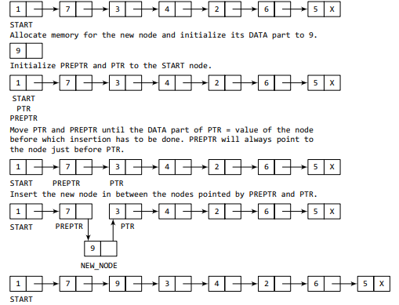
Inserting a Node Before a Given Node in a Linked List

Slide 15
Inserting a Node Before a Given Node in a Linked List
Consider the linked list shown in Fig.
Suppose we want to add a new node with value 9 before the node containing 3.
Before discussing the changes that will be done in the linked list, let us first look at the algorithm shown in Fig.
In Step 5, we take a pointer variable PTR and initialize it with START.
That is, PTR now points to the first node of the linked list.
Then, we take another pointer variable PREPTR and initialize it with PTR.
So now, PTR, PREPTR, and START are all pointing to the first node of the linked list.
In the while loop, we traverse through the linked list to reach the node that has its value equal to NUM.
We need to reach this node because the new node will be inserted before this node.
Once we reach this node, in Steps 10 and 11, we change the NEXT pointers in such a way that the new node is inserted before the desired node.

Slide 16
Deleting a Node from a Linked List
In this section, we will discuss how a node is deleted from an already existing linked list.
We will consider three cases and then see how deletion is done in each case.
Case 1: The first node is deleted.
Case 2: The last node is deleted.
Case 3: The node after a given node is deleted.
Before we describe the algorithms in all these three cases, let us first discuss an important term called UNDERFLOW.
Underflow is a condition that occurs when we try to delete a node from a linked list that is empty.
This happens when START = NULL or when there are no more nodes to delete.
Note that when we delete a node from a linked list, we actually have to free the memory occupied by that node.
The memory is returned to the free pool so that it can be used to store other programs and data.
Whatever be the case of deletion, we always change the AVAIL pointer so that it points to the address that has been recently vacated.

Slide 17

Deleting the First Node from a Linked List
Consider the linked list in Fig.
When we want to delete a node from the beginning of the list, then the following changes will be done in the linked list.

Slide 18
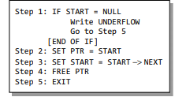
Deleting the First Node from a Linked List
Figure shows the algorithm to delete the first node from a linked list.
In Step 1, we check if the linked list exists or not.
If START = NULL, then it signifies that there are no nodes in the list and the control is transferred to the last statement of the algorithm.
However, if there are nodes in the linked list, then we use a pointer variable PTR that is set to point to the first node of the list.
For this, we initialize PTR with START that stores the address of the first node of the list.
In Step 3, START is made to point to the next node in sequence and finally the memory occupied by the node pointed by PTR (initially the first node of the list) is freed and returned to the free pool.

Slide 19
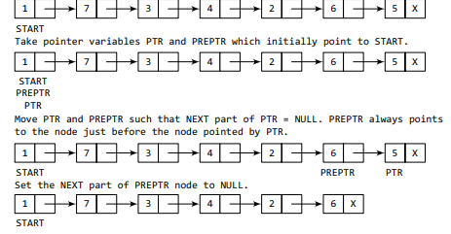
Deleting the Last Node from a Linked List
Consider the linked list shown in Fig.
Suppose we want to delete the last node from the linked list, then the following changes will be done in the linked list.

Slide 20
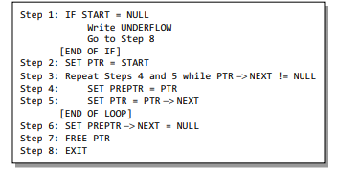
Deleting the Last Node from a Linked List
Figure shows the algorithm to delete the last node from a linked list.
In Step 2, we take a pointer variable PTR and initialize it with START.
That is, PTR now points to the first node of the linked list.
In the while loop, we take another pointer variable PREPTR such that it always points to one node before the PTR.
Once we reach the last node and the second last node, we set the NEXT pointer of the second last node to NULL, so that it now becomes the (new) last node of the linked list.
The memory of the previous last node is freed and returned back to the free pool.

Slide 21
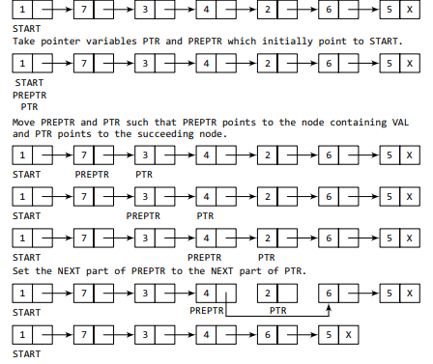
Deleting the Node After a Given Node in a Linked List
Consider the linked list shown in Fig.
Suppose we want to delete the node that succeeds the node which contains data value 4.
Then the following changes will be done in the linked list.

Slide 22
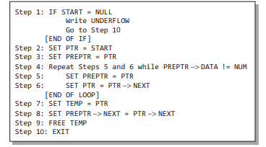
Deleting the Node After a Given Node in a Linked List
Figure shows the algorithm to delete the node after a given node from a linked list.
In Step 2, we take a pointer variable PTR and initialize it with START.
That is, PTR now points to the first node of the linked list.
In the while loop, we take another pointer variable PREPTR such that it always points to one node before the PTR.
Once we reach the node containing VAL and the node succeeding it, we set the next pointer of the node containing VAL to the address contained in next field of the node succeeding it.
The memory of the node succeeding the given node is freed and returned back to the free pool.

